Slide 1
SMALL HOMES – AN OPTION FOR LIVING WELL
Learning from Good Samaritan Cottage Model

Slide 2
Beginnings
Established first cottage in 1995
Originally developed based on theory behind a Swedish model (Beck Friis, At Home in Balzar Garden, 1988)
Notes:
GSS was a pioneer in the industry establishing its first cottage 28 years ago in 1995 based on a model from Sweden that contemplated caring for persons with dementia in a familiar home-like environment would result in improved quality of life.

Slide 3
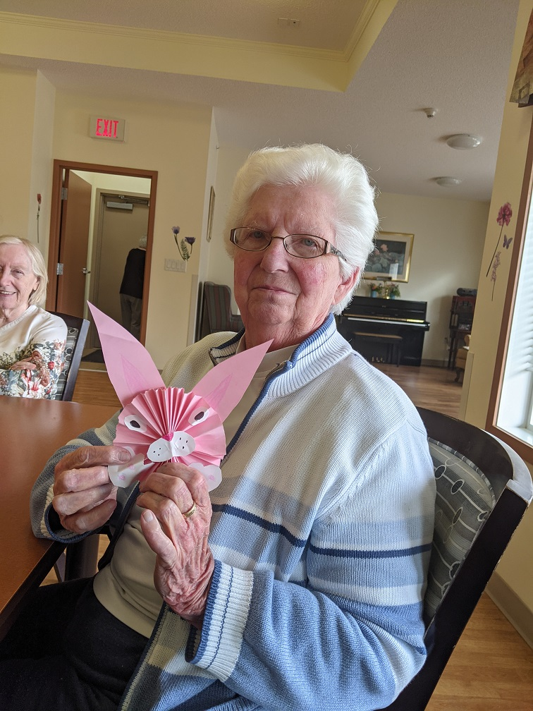
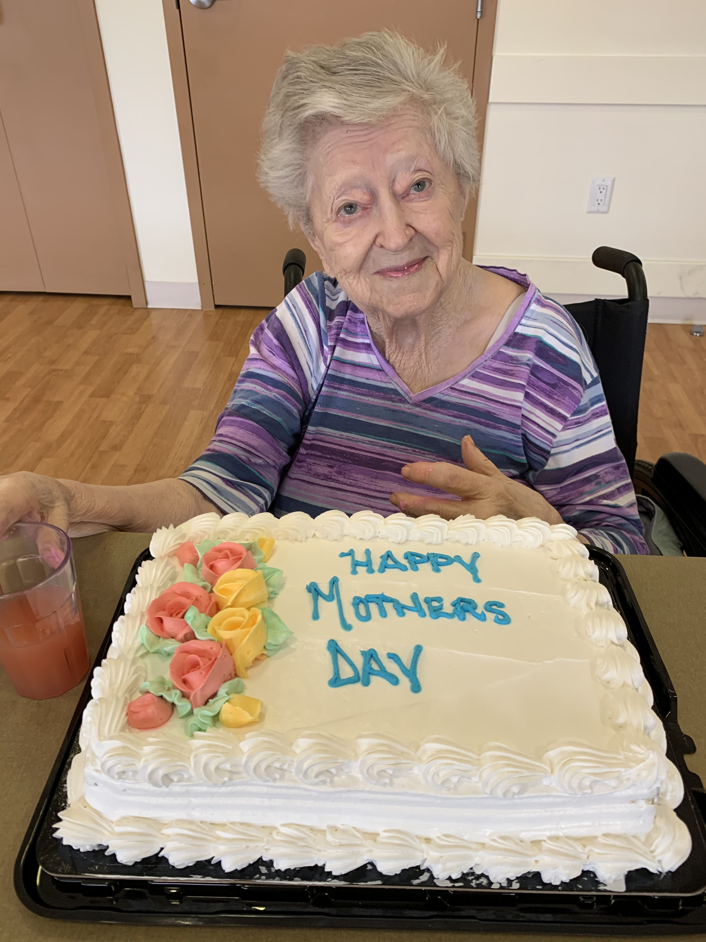
Dementia Cottage
10 – 12 Residents
Notes:
At the time our Cottages were designed based on the following principles, privacy, individuality, independence, dignity and choice
Our existing Cottages are home to 10-12 residents depending on the size of the home and they were built open concept with private bedrooms and two shared bathrooms per unit.
Homes were designed to create a safe & secure environment in a familiar, home-like setting that include secured indoor and outdoor spaces, specialized equipment to meet resident needs, consistent staffing, lower staff/resident ratios and multi-skilled staff
The familiar home-like setting serves as a cue to memory and behaviors and programming that is centered on providing meaningful, familiar activities that lend themselves to the normal routines of daily living.
Success with the model resulted in expansion over time and today we have 19 cottages in BC (218 spaces) and 25 in Alberta (284 spaces).
While I share our organization’s experience, we want to recognize other pioneers of this important concept some of whom include CareWest, Bethany Care Centre, Capital Care , & ExquisiCare and the work of Calgary’s Dementia Network in engaging potential clients and providers to set out a path moving forward.

Slide 4
Time for Change: THE IMPLICATIONS
Alberta Opportunity
Staffing Model
Person Centered Education
Creativity to meet the needs of diverse resident populations.
Cost of Capital
Capital Funding Model
Operational Funding Model
Education Preparation
System Design Considerations
Notes:
As we heard from John and Linda it is a time for change given the changing expectations of residents, families and the public at large. Overtime, the model of care and environmental improvements have enhanced our ability to provide services as demonstrated with the Green House Model.
Furthermore, it is great start to see Alberta’s Commitment in 2023/24 Budget plans to expand the Small Home Opportunities.
Our Good Samaritan experience echo's the observations of the Green House Model experts that there are important considerations in moving forward to
ensure today’s challenges do not become barrier to future success:
There are increased costs of capital construction must be considered as being offset by quality of life & system benefits
The funding needs to support Sufficient Staffing and working to full scope with a shift to accountability for outcomes
Our education programs need to better prepare employees for person-centered care and roles as team leaders
And finally with the opportunity for innovation that is attached to this model we must open our minds to think broadly and creatively about how these small home living environments can be created in a range of settings to serve different resident populations with varying care requirements (for example we may require a shift in policies and/or funding need to meet resident need).
Good Samaritan is certainly excited by Alberta’s potential to expand Small homes options for community- based living and to develop plans to evaluate impact for ongoing learning.
I am also interested to see how we can incorporate concepts for healthy communities as described by Dr. Lee.

Slide 5
The VALUE
Small Homes - Living Well
Real Homes
Meaningful Living
Empowered Caregivers
Notes:
The value:
Homes centered in the heart of communities, designed for a maximum of 14 elders with private bedrooms, attached washrooms and central lving spaces with access to outdoor spaces
Person centered care that focuses on being and belonging; maintaining autonomy, control and purposeful living that embraces an individuals choice and preferences
And an empowered team of caregivers that work to their full scope assuming responsibility for a range of personal, clinical and home care activities.

Slide 6
The BENEFITS
Resident & Family Wellbeing
Employee Satisfaction & Retention
Health Care System
Flexibility for rural & urban settings
Notes:
The gains:
Increased resident and family satisfaction – a good life that promotes autonomy, dignity, choice and quality of living
The focus on employee development such as enhanced training, engagement, collaboration, and shared decision-making promote overall satisfaction and retention
System benefits include the promotion of aging in place, reduced infection prevention & control issues such as outbreaks and outcomes that include collaborative, resident-directed care and other quality of life indicators that we should likely advocate to be included among more traditional health-related quality of care indicators
Furthermore, enhancing the availability of small homes in both rural and urban settings again provides choice and it will enhance our ability to meet the diverse needs of the people we will be increasingly called upon to serve.

Slide 7
Small Homes
An option for living well…an asset in healthy communities!
Notes:
Ultimately, when it comes to care there is not a “one size fits all approach” – but the small home model does provide an innovative, alternative option that promotes inclusiveness, autonomy, dignity, choice, independence and community connection which is simply the “right thing to do.”

