Slide 1
Cohousing:
An innovative
community approach
to aging-in-place
Notes:
Title Page

Slide 2
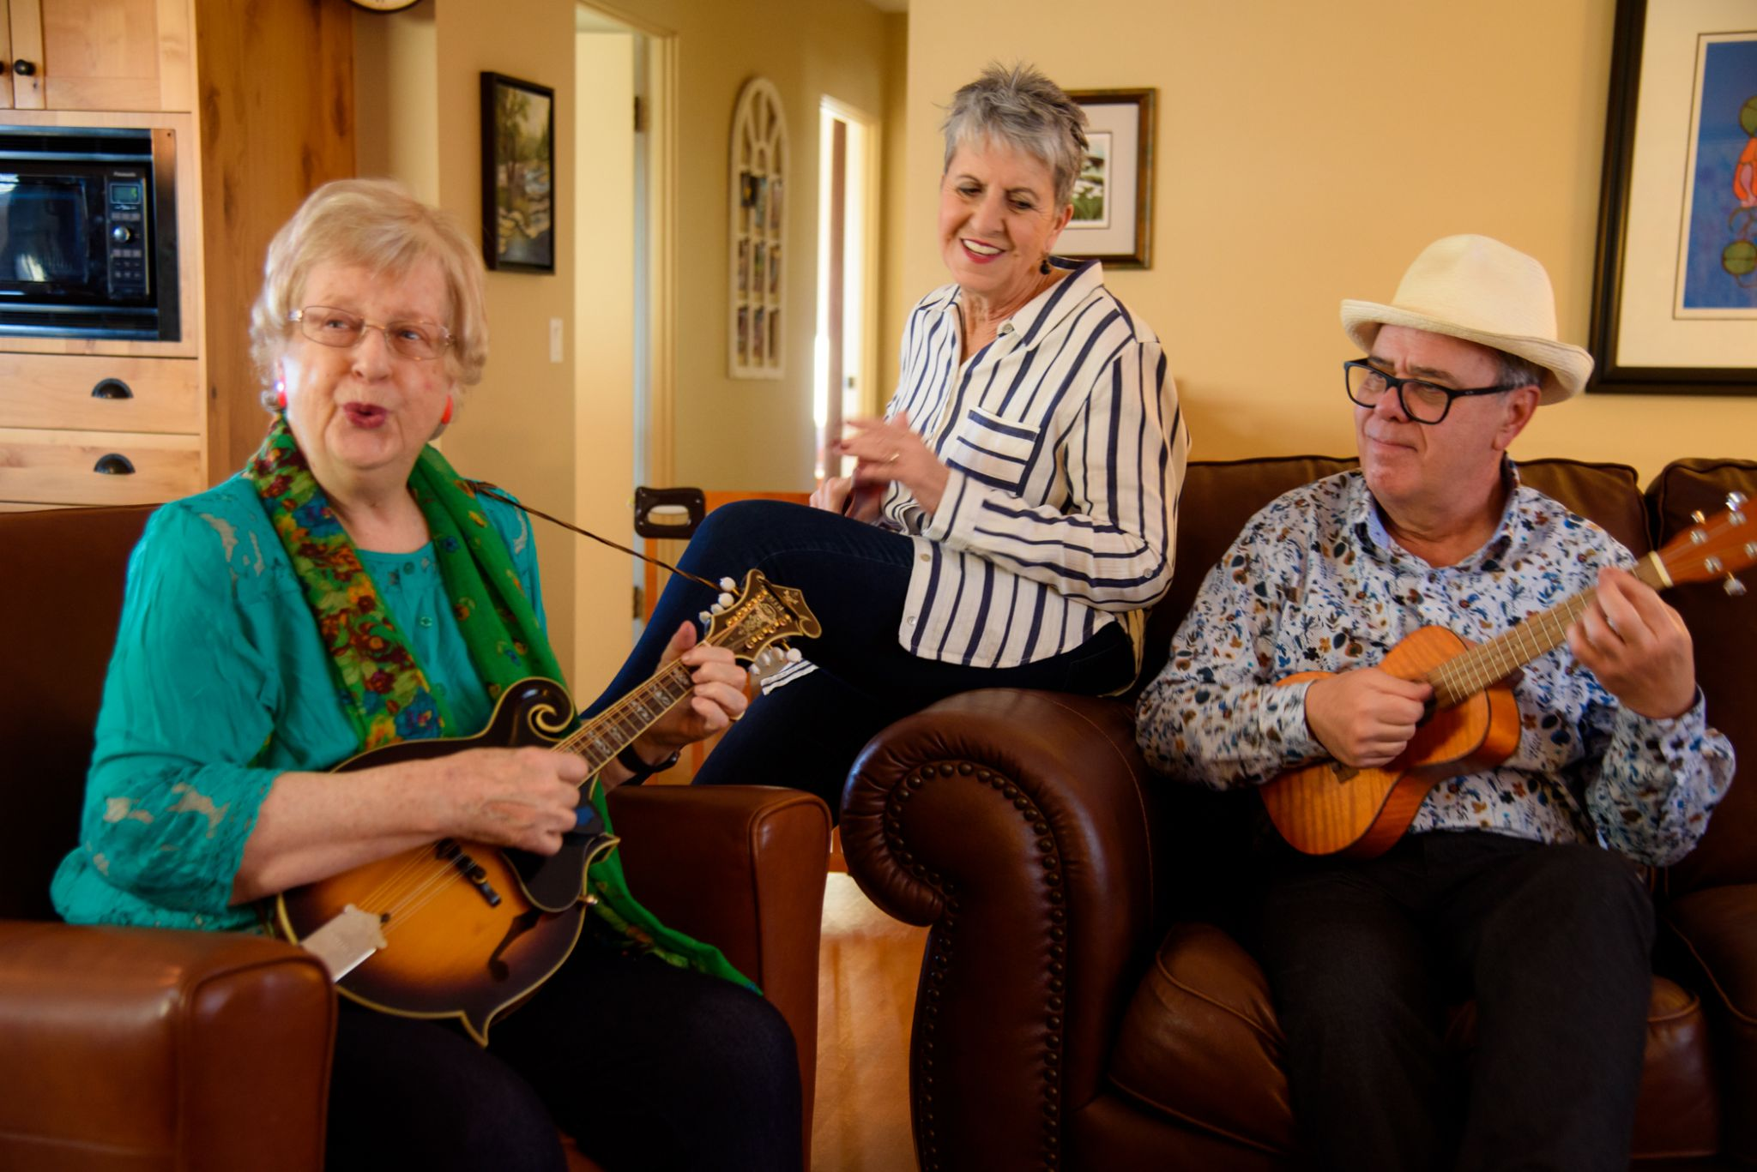
WHAT IS COHOUSING:
Private fully-equipped dwellings
Extensive common house or area
The heart of a cohousing community
Community dinners, events, meetings, parties
Recreation areas for:
Numerous other organized formal and informal activities.
Notes:
A Model of housing. It is not a legal entity.

Slide 3
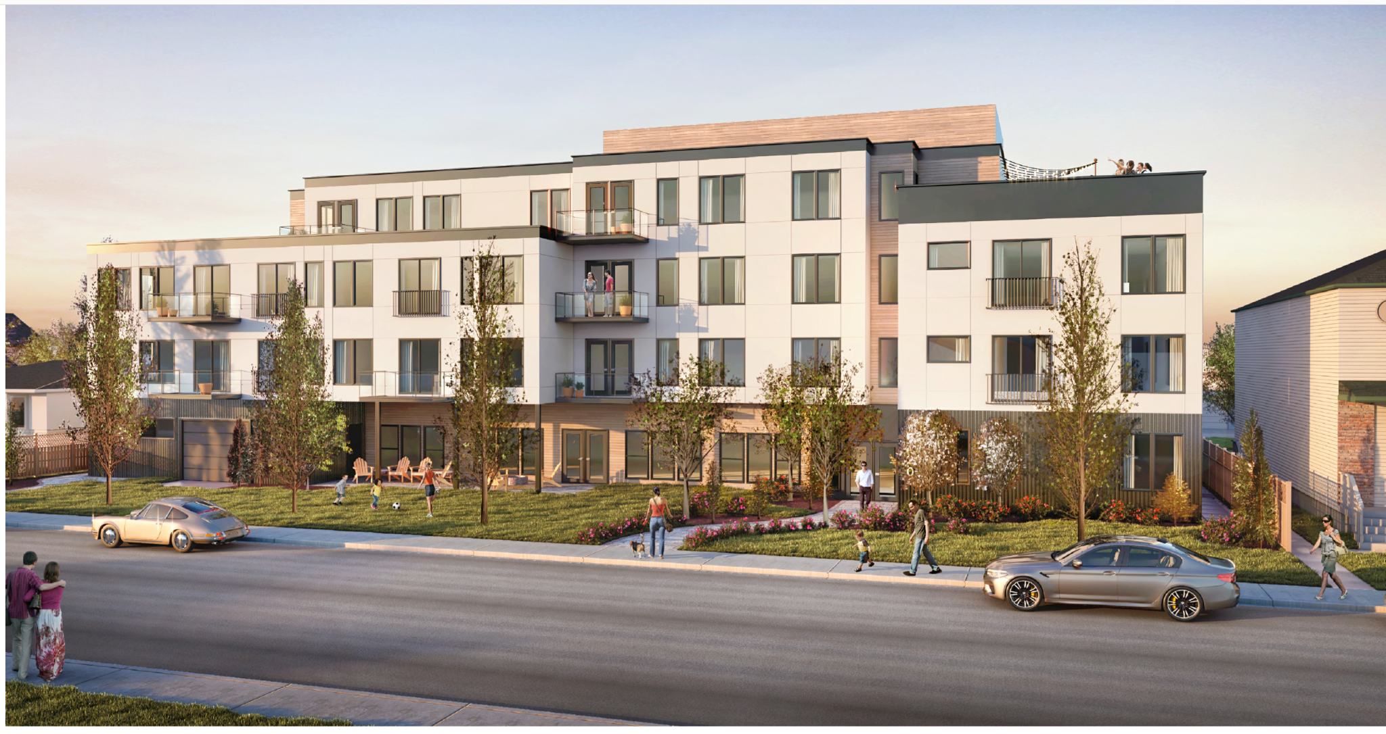
Rendering of Mosaic Village Building

Slide 4
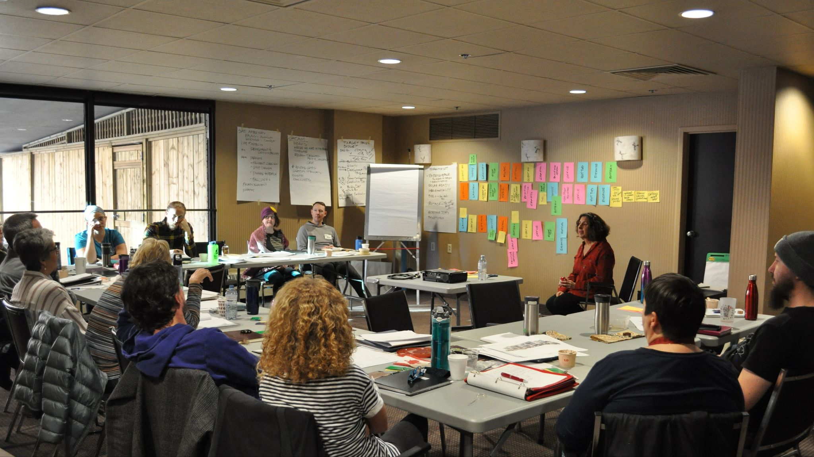
Conclusion:
If we are serious about wanting different housing options then…
We must be willing to work outside the box:
We must find ways to engage citizens who are willing to create good housing options
This model works. but it will only work well if all three levels of government work with us.
Funding / land / consultations will be helpful
A financial developer would have been helpful
Being a sideline cheerleader is not very helpful

