Slide 1
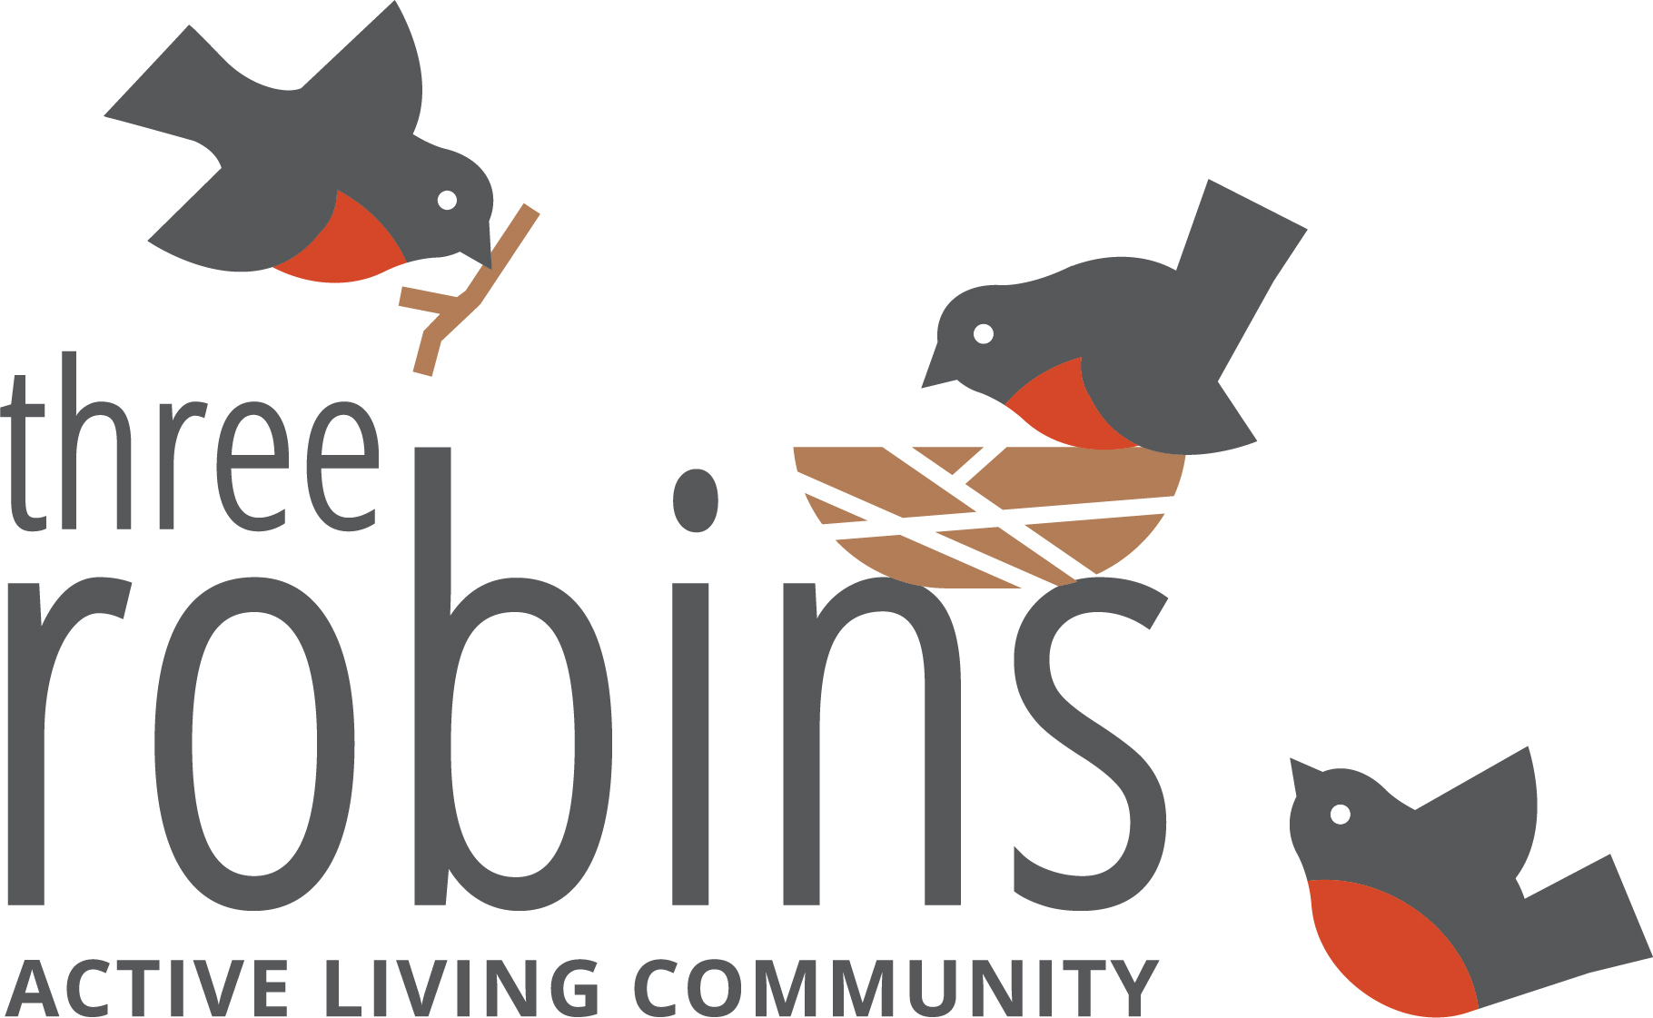
Three Robins Active Living Community A New Vision for Senior Living

Slide 2
Framework for Creating Three Robins
What is the Difference Between Three Robins and a Retirement Residence?
Three Robins are active adult communities for those 55+ who wish to maintain their independent lifestyle without the responsibility of home ownership and maintenance. Independence breeds wellness.
Residents of Three Robins can choose additional services a la carte, including housekeeping, laundry and meal delivery, but are not required to pay for any services they do not want or need.
Senior care residences are for seniors who require a higher level of care including health care and all meals. Three Robins is needed option between living at home and retirement residences.

Slide 3
Framework for Creating Three Robins
The Volunteer Program
Tenant's rent is reduced by $200 per month if they volunteer 10 hours per month in the building or in the community.
There are many different volunteer opportunities, and if a resident does not find one that interests them, they are welcome to suggest their own. Every resident is encouraged to find a volunteer opportunity that they are passionate about.
Volunteer options can include: the kitchen committee, welcome desk, woodshop helpers, gardening committee, quilting blankets for cancer patients, event set up/tear down, health and safety committee, resident council, and many more.

Slide 4
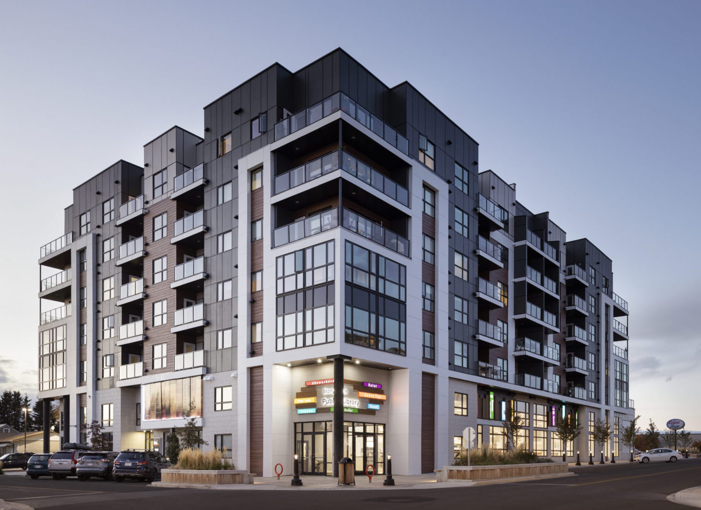
Framework for Creating Three Robins
Full-time General Manager, Community Engagement Coordinator and maintenance expert on-site
Handicap accessible
Pet Friendly
Additional storage space available
Non-smoking
Heated underground and surface parking

Slide 5
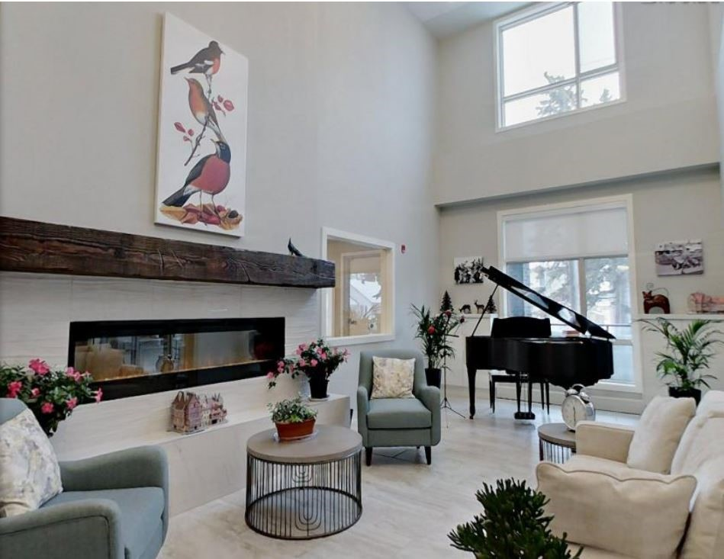
What is Included with Rent
All utilities (electricity, hydro, water, & sewer)
Access to all amenities (woodshop, exercise room/movement studio, craft room, communal kitchen/dining room)
General repairs in your suite
Equipment maintenance, snow removal, and more

Slide 6
Results
Occupancy: 89 residents in Red Deer and 85 residents in Stony Plain despite opening in a pandemic!
Volunteering supports personal investment in 3 Robins success.
Programming is Resident run and determined.
Improved interaction and buddy system prevents advancing to higher levels of care.
Designed to physically and psychologically represent a family and neighbourhood.

Slide 7
Successes and Barriers
Why it’s the Future
What are the Risks
Lessons Learned

Slide 8
Testimonials
From Red Deer and Stony Plain

